Slide 1
Final Projects
Sketchy, Othello, Pacman, Evolution, Indy
Notes:
2:31

Slide 2
Sketchy
TAs: Taylor, Lucy, Aalia, Andy, Wambui, Cooper, Dora, Georgia, Lily, Niyoshi, Olivia, Nicole, Milla
Notes:
2:32

Slide 3
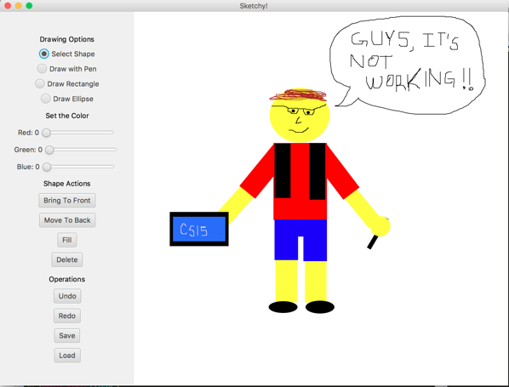
Some info
Build an application which lets you make art
Manipulate shapes (fill color, resize, rotate, etc.)
Draw lines
Layer shapes
Undo/Redo
File saving and loading

Slide 4
Video
Notes:
2:40

Slide 5

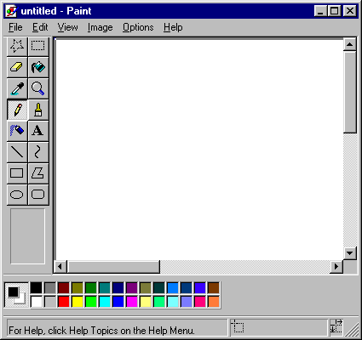

Top 5 Reasons to do Sketchy (1/5)
Sketchy = literally the greatest product ever designed
Adobe Photoshop = really complicated????
Windows Paint =
Notes:
2:41

Slide 6
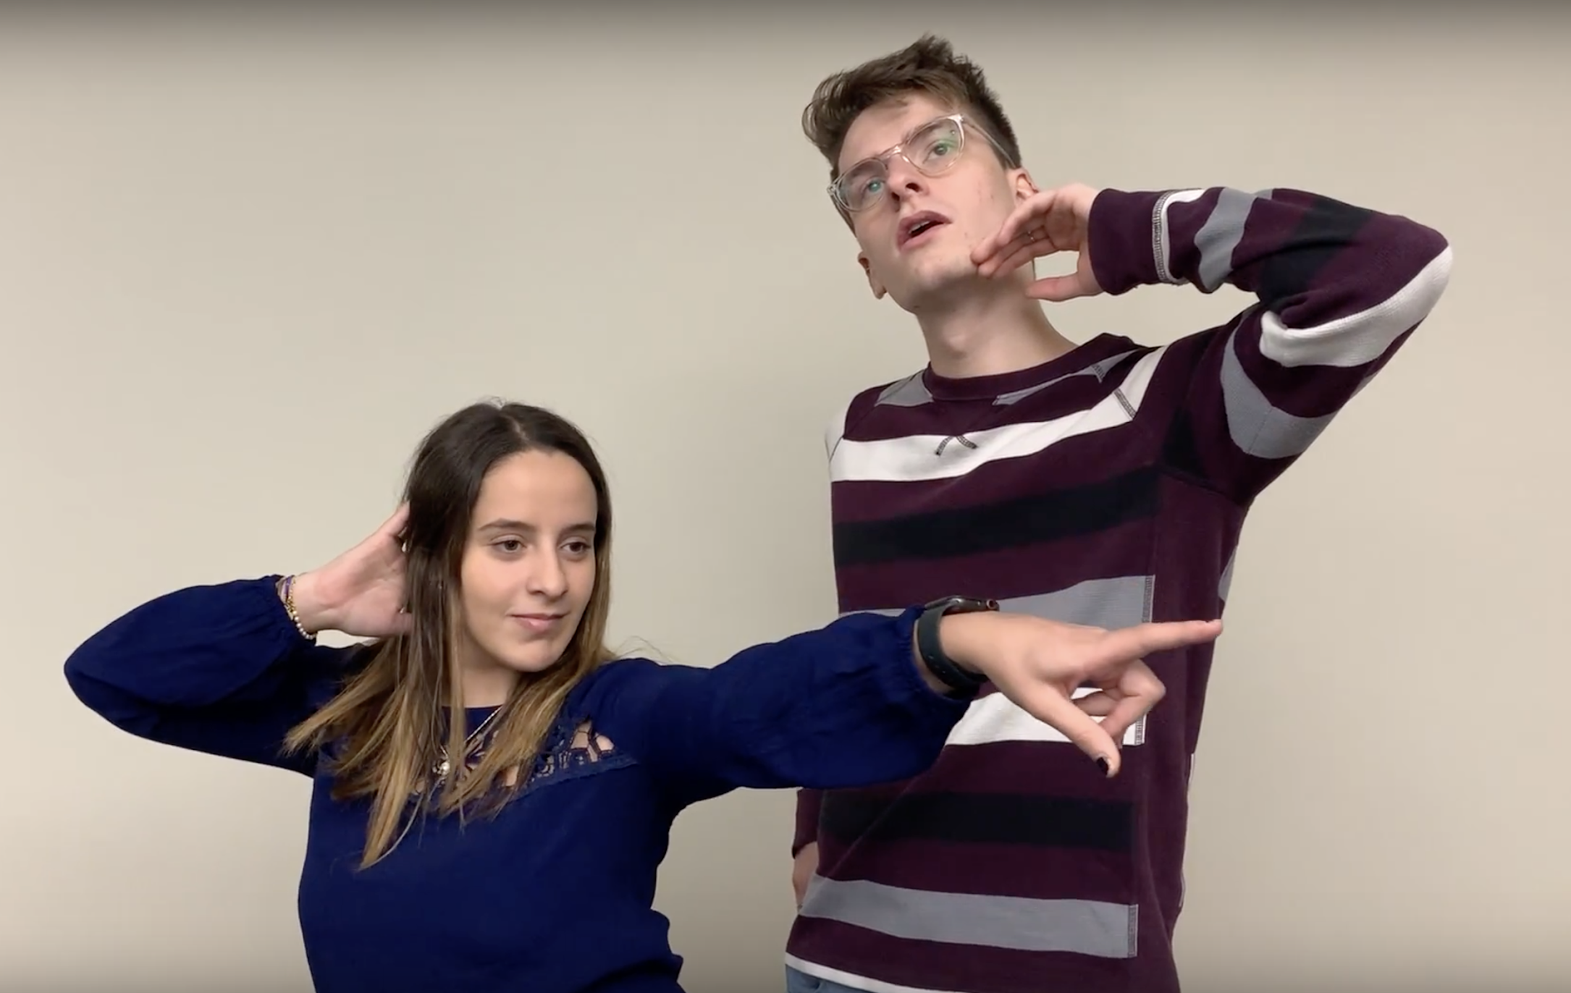
Top 5 Reasons to do Sketchy (2/5)
2 HTAs for the price of 1
i mean look at them
Notes:
2:41

Slide 7

Top 5 Reasons to do Sketchy (3/5)
You never have to use Arrays again. Ever.*
int[ ][ ] nums = new int[10][10]
*We can’t actually guarantee that you’ll never use them again in your life. Sorry.
Notes:
2:42

Slide 8
Top 5 Reasons to do Sketchy (4/5)
I’m sorry, was one shitty arcade game not good enough for you ????
We don’t play games.
Notes:
2:42

Slide 9
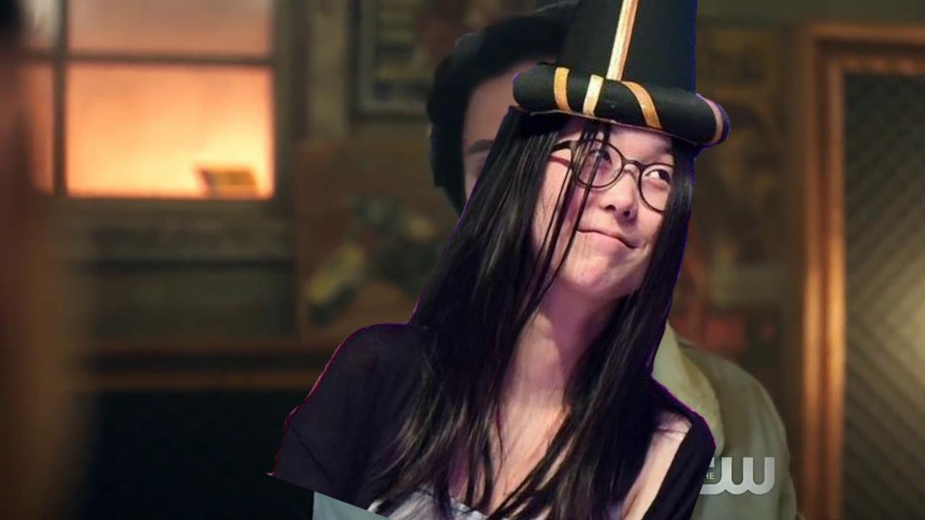
Top 5 Reasons to do Sketchy (5/5)
Real footage of Indy HTA Julie Wang talking about being ~quirky~ and ~not like other TAs~
Notes:
2:43

Slide 10
Demo
Notes:
2:45

Slide 11
Othello
TAs: Noah, Maura, Gil, Julia, Lisa, Lucy W., Marina, Selena, Sierra, Tom, Tzion
Notes:
2:46

Slide 12
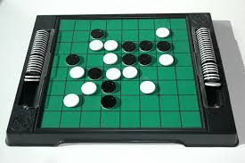
Some info
Othello is a two-player strategy board game also known as Reversi
Create your own multi-level Artificial Intelligence (AI) player that can play a human user or another AI
Have ~fun with recursion~ and make an interactive GUI
Notes:
2:47

Slide 13
Video
Notes:
2:53

Slide 14
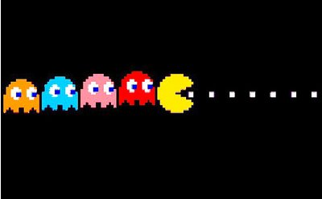
Top 5 Reasons to do Othello (1/5)
Because who wants to make another composite shape again
(I mean just look at those ghosts)
(and Sketchy is literally just a tool to make MORE composite shapes)
Notes:
2:54

Slide 15
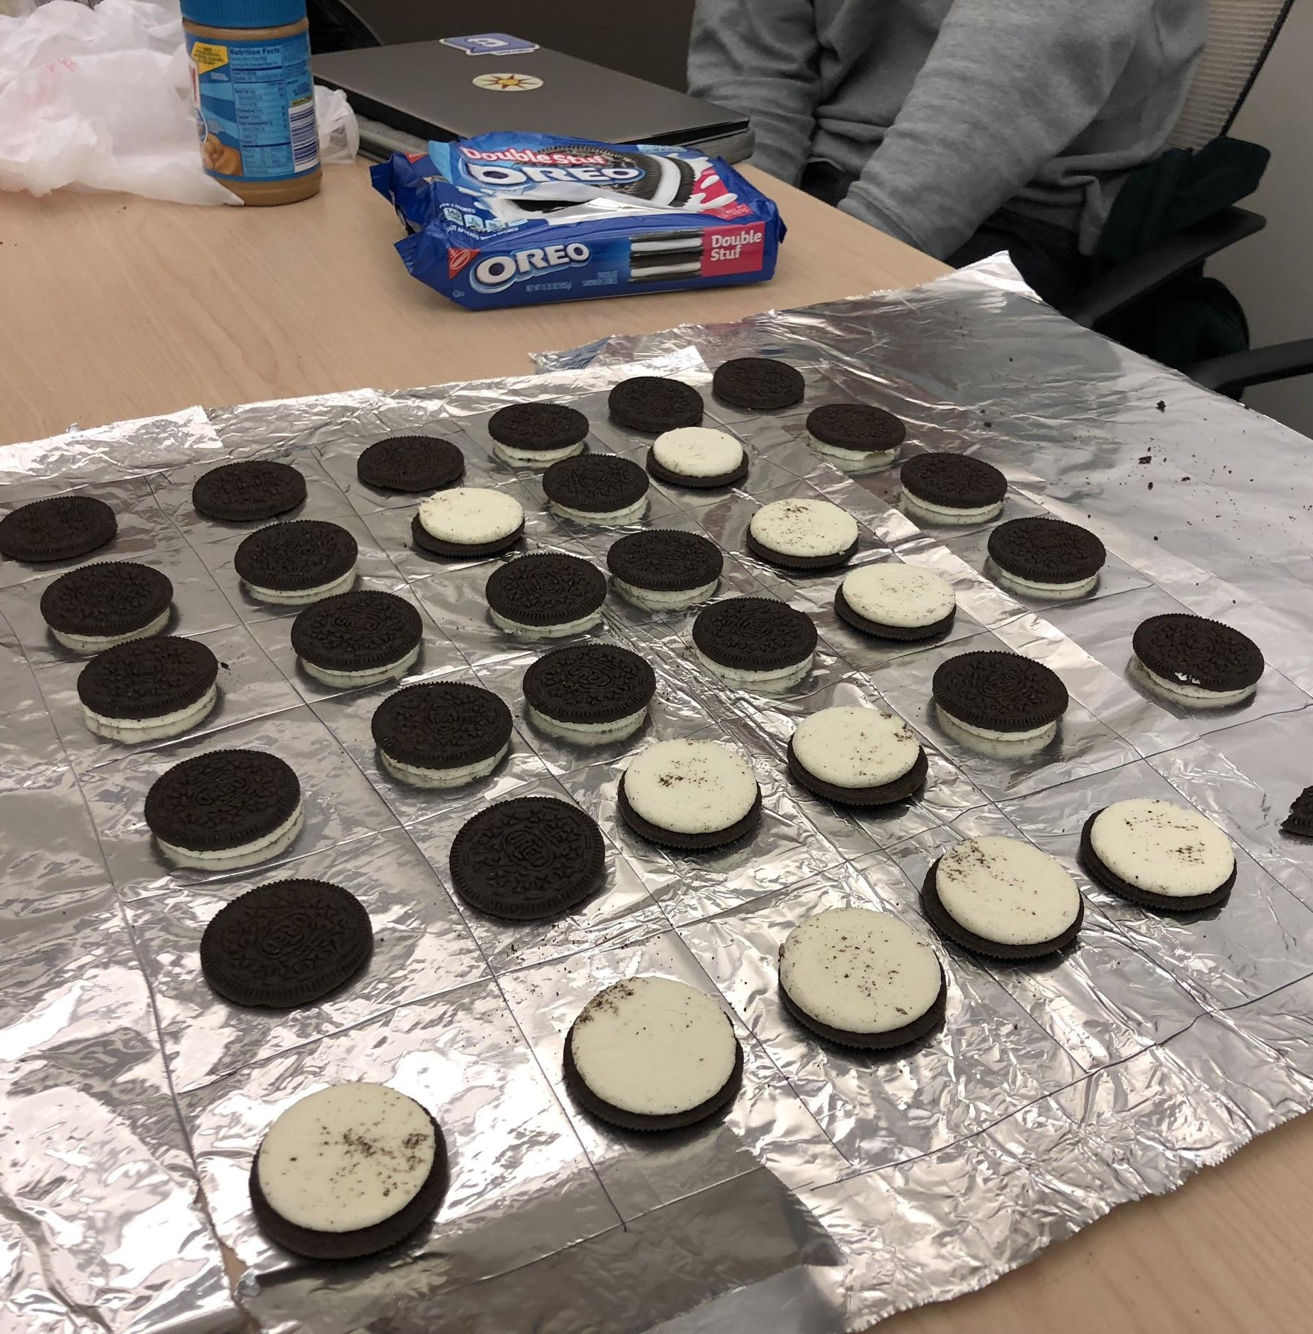
Top 5 Reasons to do Othello (2/5)
You can play with Oreos.
No argument necessary really. How could you pass this up?
Notes:
2:55

Slide 16
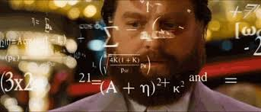
Top 5 Reasons to do Othello (3/5)
All CS15 TAs that did Othello are now CS15 TAs
Notes:
2:56

Slide 17
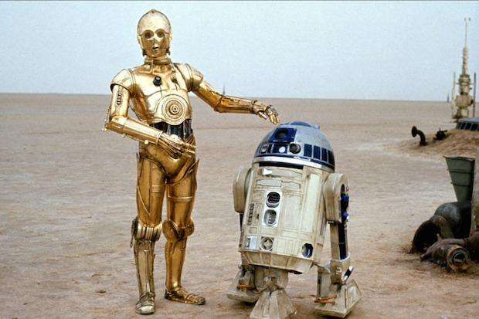

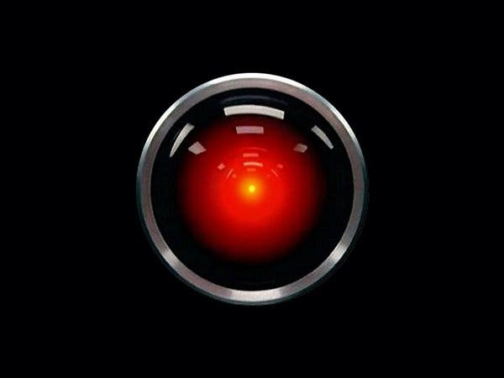

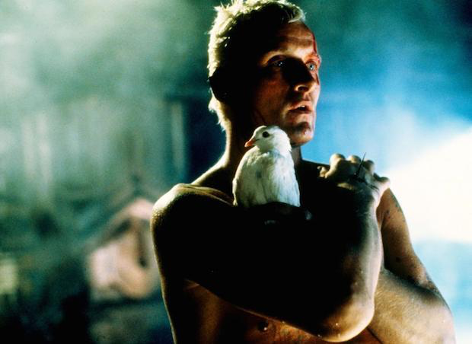
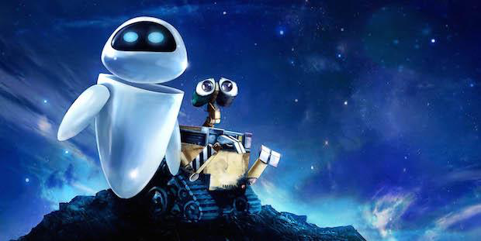
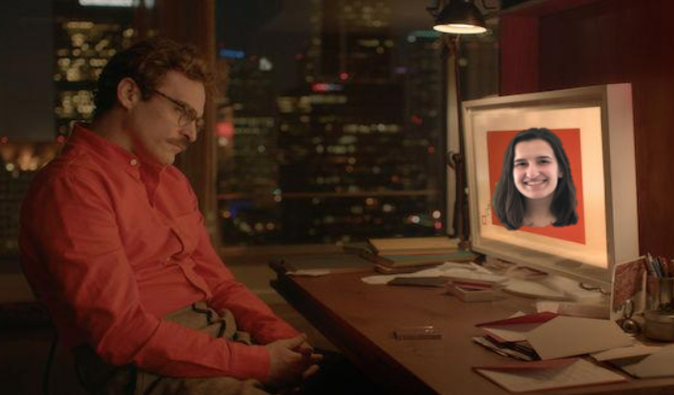


Top 5 Reasons to do Othello (4/5)
It’s more than creating a project.
It’s creating a long-lasting friendship.
Notes:
2:57

Slide 18
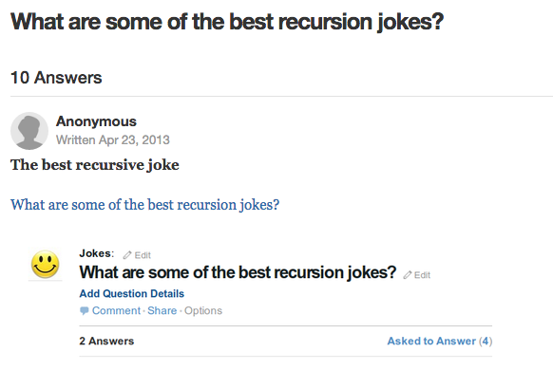
Top 5 Reasons to do Othello (5/5)
Your friends will never get tired of your super original and witty recursion jokes
Notes:
2:58

Slide 19
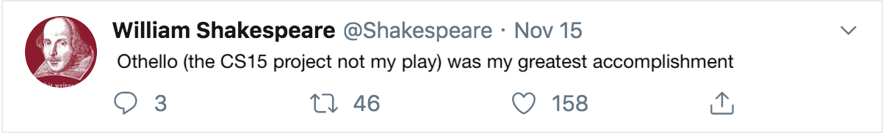
Top 5 Reasons to do Othello (6/5)
Even Shakespeare says Othello was his greatest accomplishment

Slide 20
Demos
Notes:
2:59

Slide 21
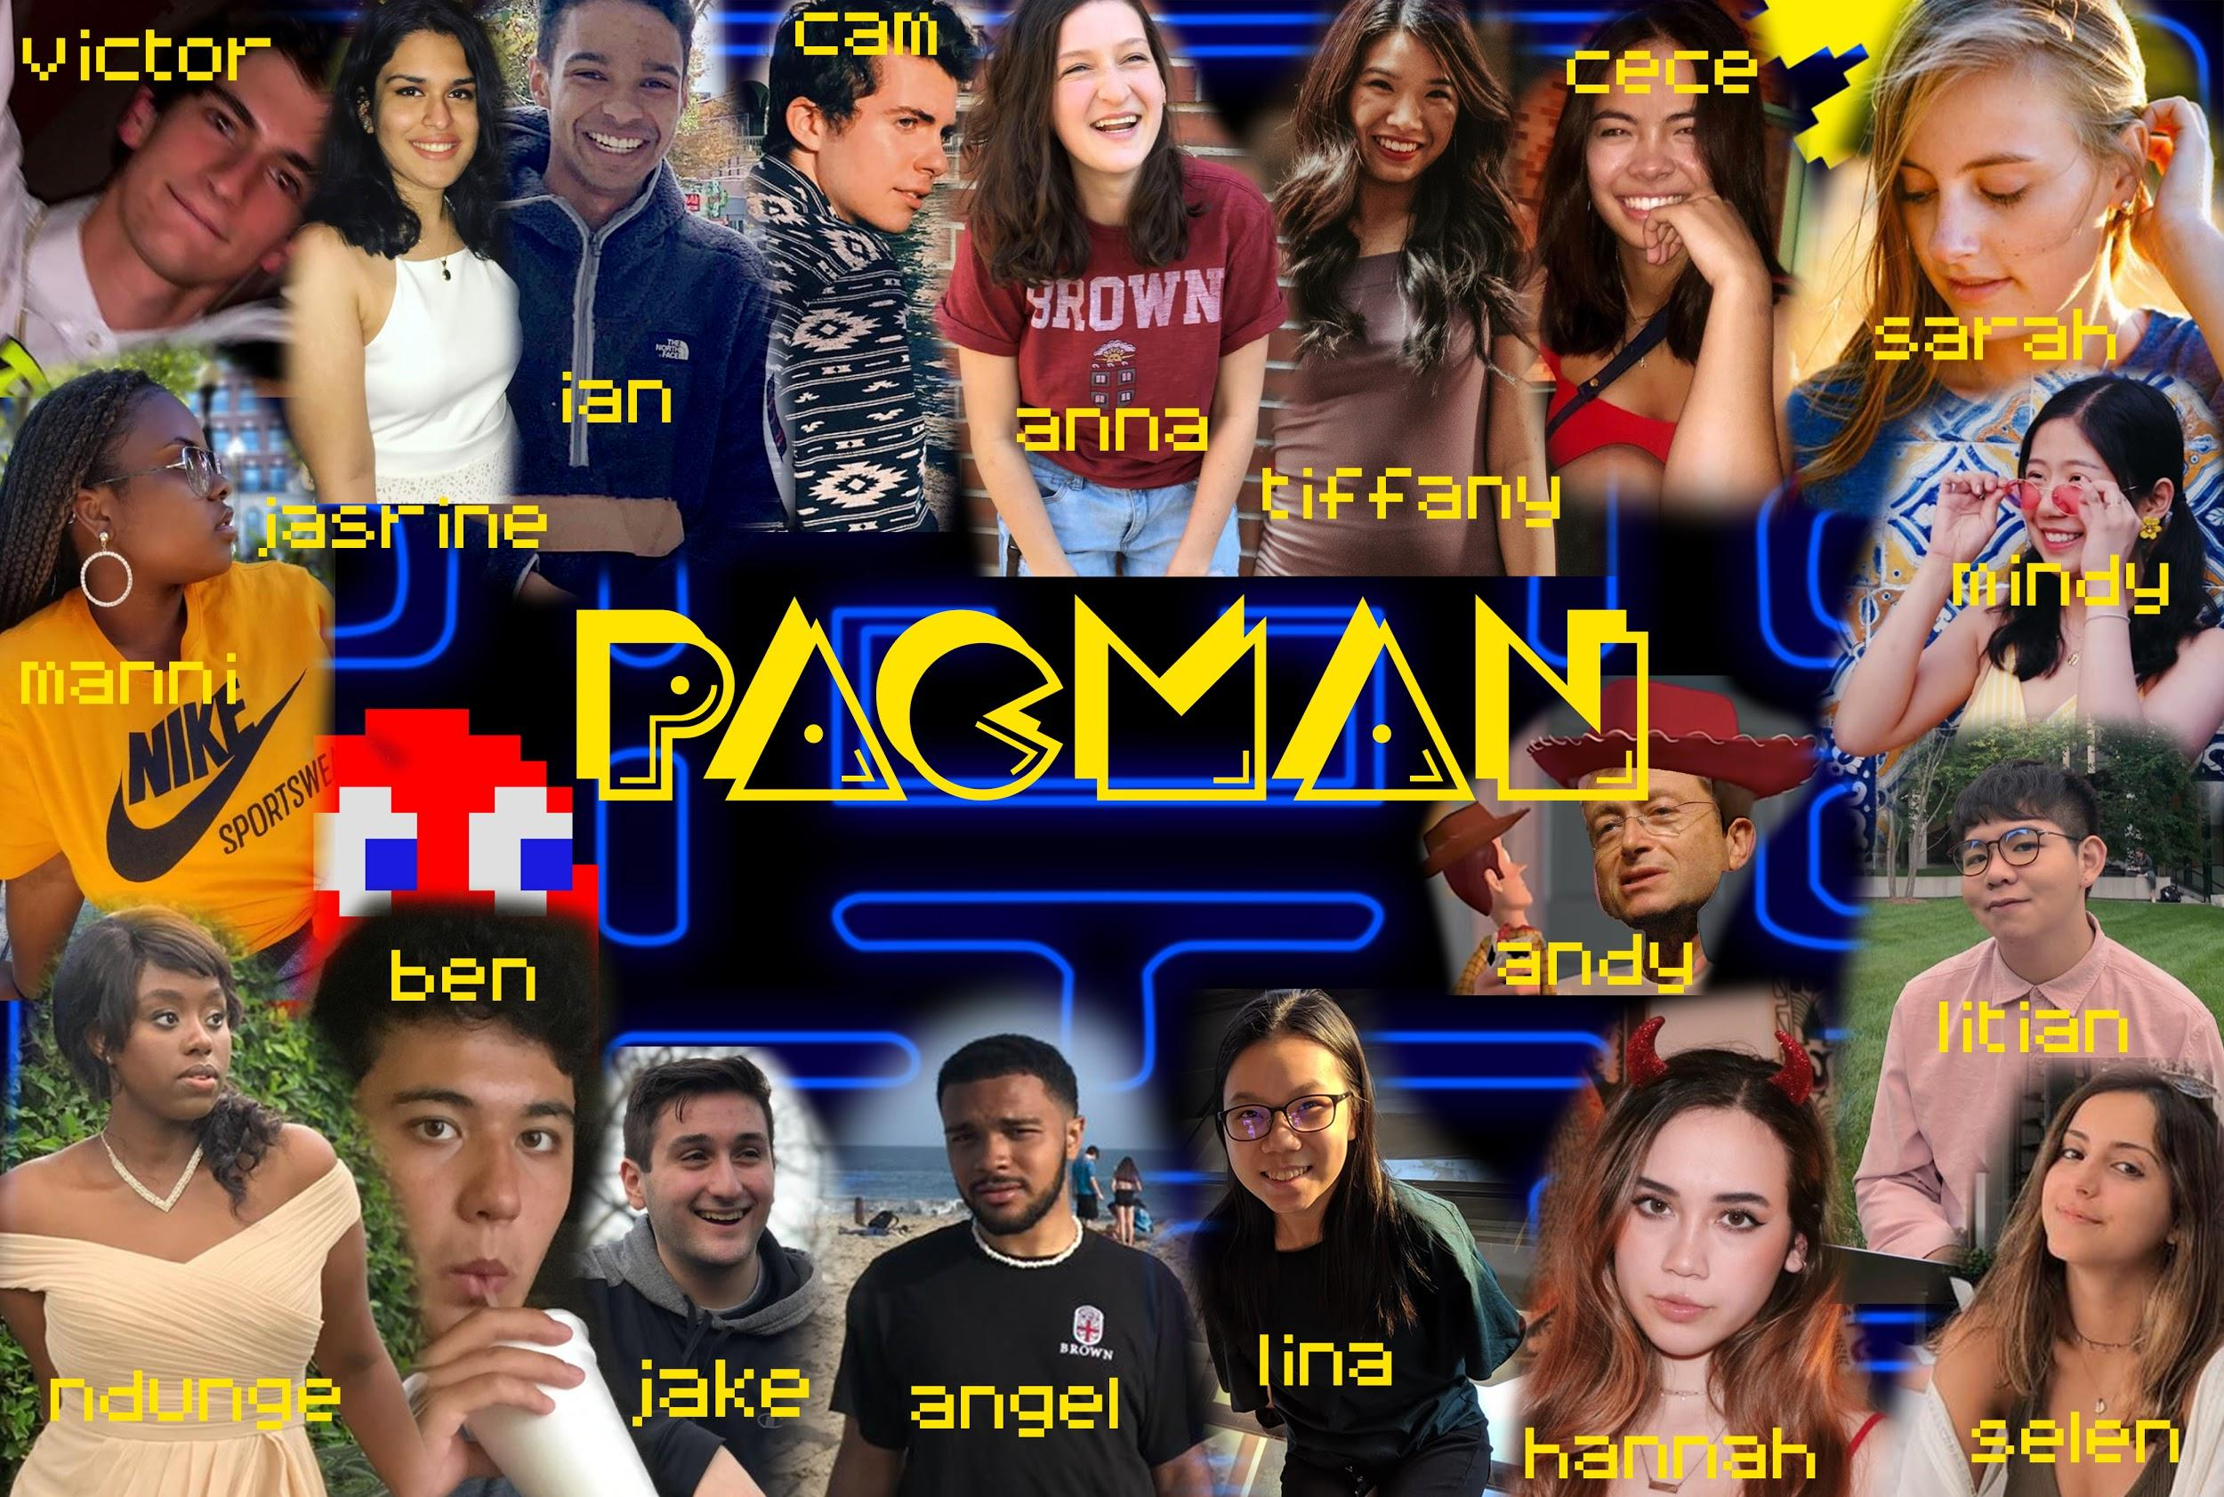
Notes:
3:02

Slide 22
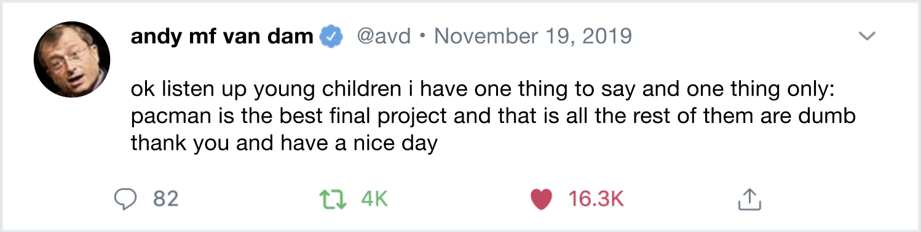
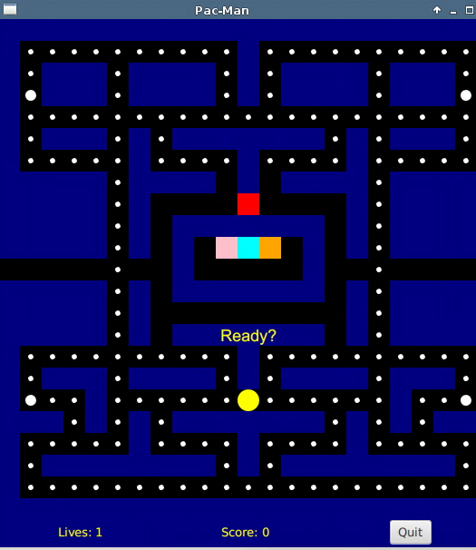
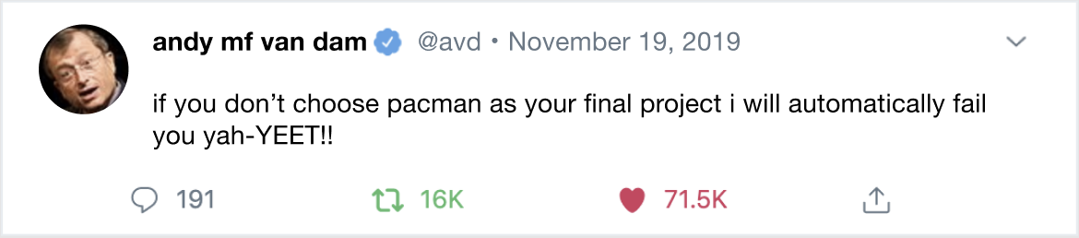
Some info
RADICAL!
Super rad arcade game
Write an AI for the Ghosts by implementing a Breadth-First Search algorithm
Play against said ghosts as you “test your game”
Opportunities for fun extra credit like fruit and extra levels
RETRO!
SO MUCH FUN ™️
Notes:
3:03

Slide 23
Video
Notes:
3:07

Slide 24
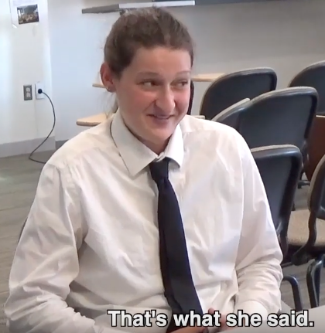
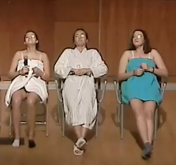
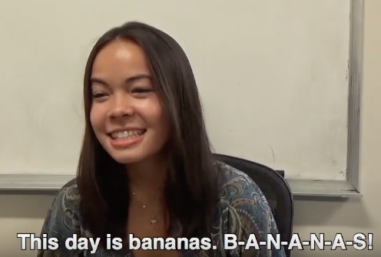
Top 5 Reasons to do Pacman (1/5)
Have you been having trouble landing your jokes?
Do you want people to think that you’re funny?
“Before doing Pacman I had never told a joke. After completing Pacman, people won’t stop laughing at me ” -cvogler
2/3 Humor TAs did Pacman!
Notes:
3:07

Slide 25
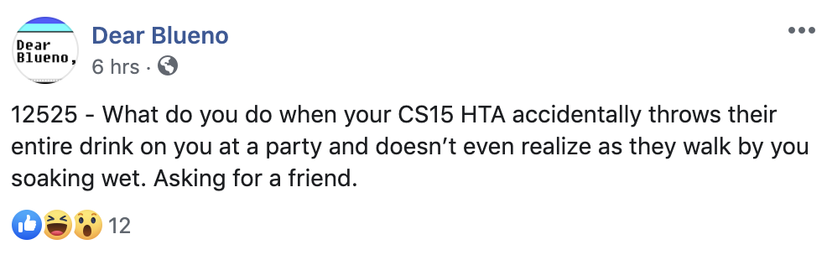

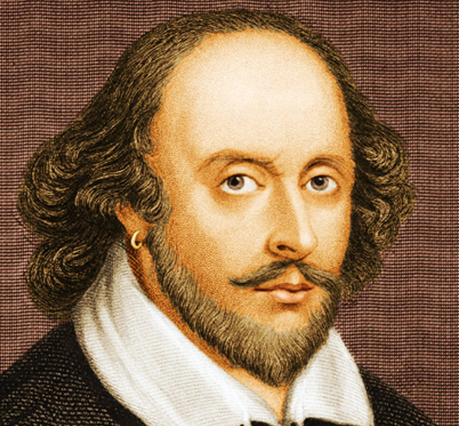

Top 5 Reasons to do Pacman (2/5)
I h8 u
o(k)
Even Shakespeare hates Othello.
“To be or not to be, that is the question. To do Othello or not to do Othello, that... that is not even a question.”
(Hamlet, Act III, Scene I)
Notes:
3:08

Slide 26
Top 5 Reasons to do Pacman (3/5)
Sketchy is all about pretty pictures
so we took a relevant screenshot:
Notes:
3:08

Slide 27
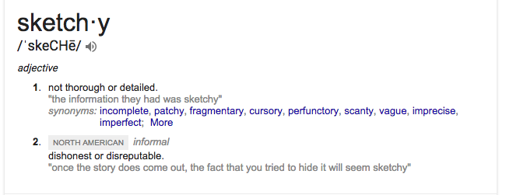
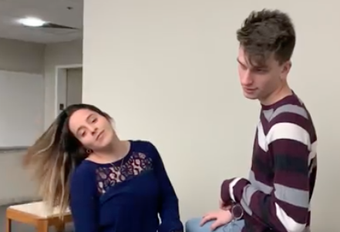
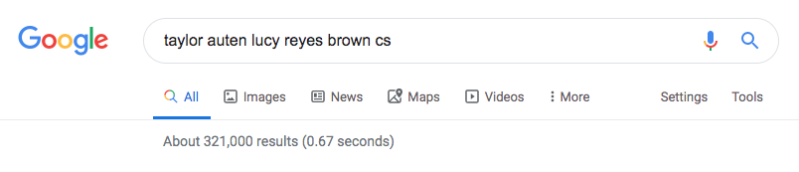
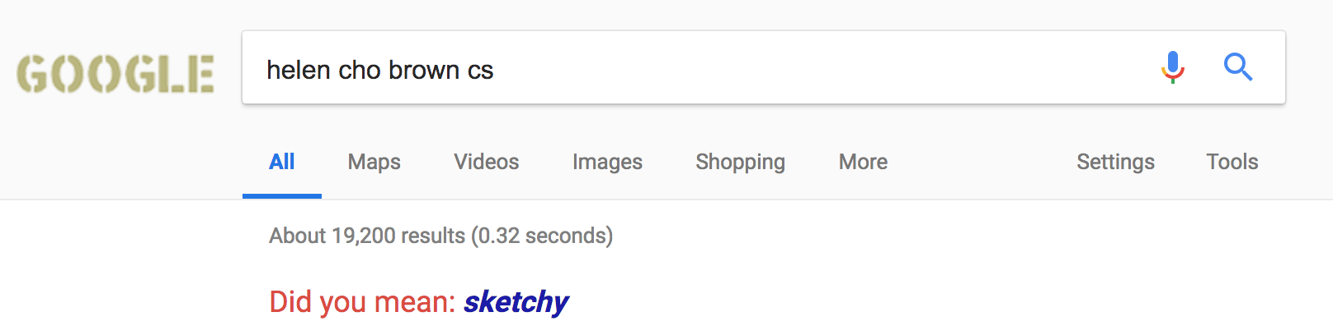
Top 5 Reasons to do Pacman (3/5)
Notes:
3:08

Slide 28
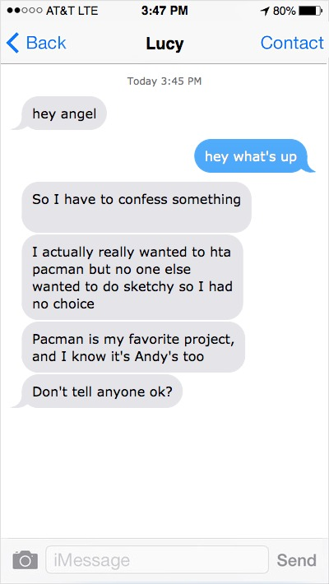
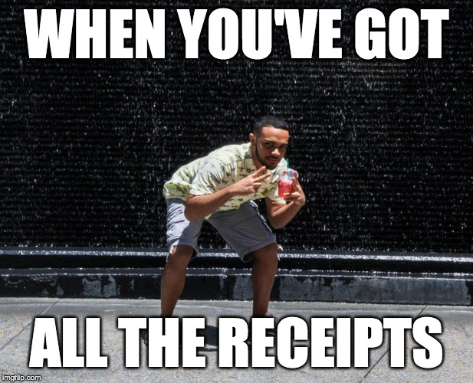
Top 5 Reasons to do Pacman (4/5)
A 100% REAL SCREENSHOT
All of the Sketchy TAs actually have a deep passion for Pacman but were reassigned to Sketchy to meet TA quotas
Notes:
3:09

Slide 29



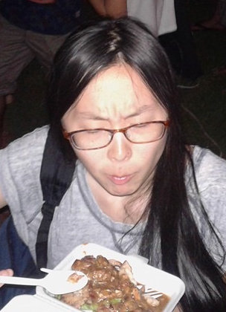

Top 5 Reasons to do Pacman (5/5)
Indy? More like IntheCITallthetime
“i hAvE pRiOr cOdiNg eXpErIeNcE”
Notes:
3:09

Slide 30
Demos
Notes:
3:14

Slide 31


TAs: Noah, Mikey, Marlene, Madison, Rachel, Julie, Zoe, Zach, Will
Notes:
3:15

Slide 32
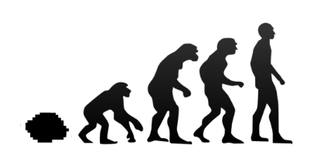
Some info
A brand new final project!
ML based project where Birds learn how to play FlappyBird on their own
Broken up into 3 parts:
Part 1: Code FlappyBird (it’s like an easier DoodleJump)
Part 2: Make a population of birds that learn how to beat the game by themselves!
Part 3: Optimize your design
Go through the super satisfying experience of watching your bird babies learn to fly hnnng
Notes:
3:16 then SKIT

Slide 33
Some More info
Since this project is brand new, we will be restricting the number of students that can take this project.
You must fill out the form at the top of the handout by Wednesday (tomorrow, 11/20) at noon to be considered.
You’ll hear back Wednesday (tomorrow) night

Slide 34
Generation 1
Notes:
3:07

Slide 35
Generation 2
Notes:
3:07

Slide 36
Generation 3
Notes:
3:07

Slide 37
Generation 4
Notes:
3:07

Slide 38
Generation 5
Notes:
3:07

Slide 39
Generation 6
Notes:
3:07

Slide 40
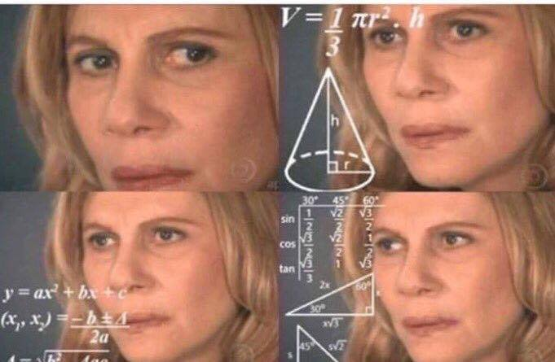
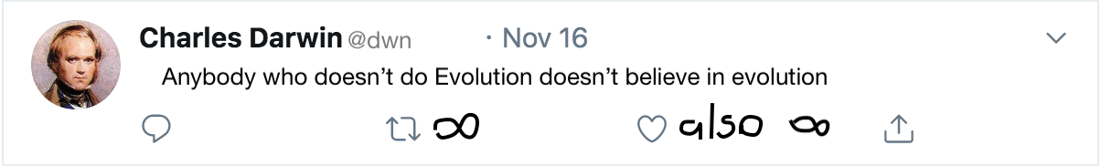
Top 5 Reasons to do Evolution (1/5)
If you choose another FP it means you don’t believe in evolution
*made in shitty microsoft paint sketchy
Notes:
3:21

Slide 41
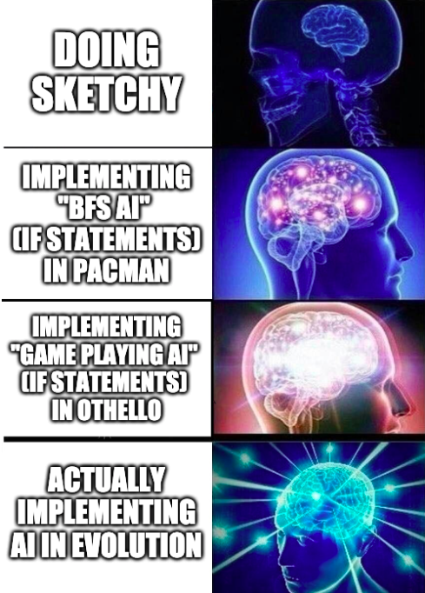
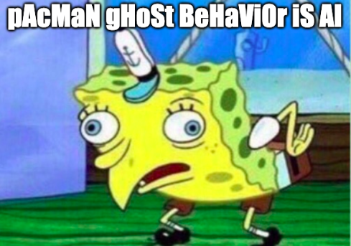
Top 5 Reasons to do Evolution (2/5)
It’s the only project that actually has AI
Notes:
3:22

Slide 42
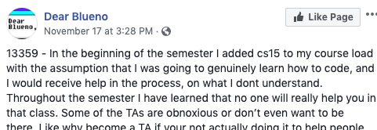
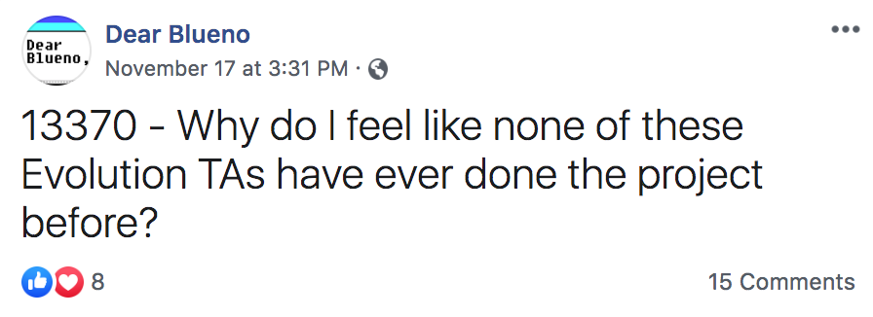
Top 5 Reasons to do Evolution (3/5)
Because no one has ever TA’d this project before, there will be ample opportunities to post about how bad we are on Dear Blueno
Notes:
3:22

Slide 43
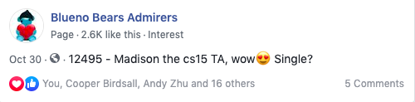
Top 5 Reasons to do Evolution (4/5)
Because we are the most attractive TAs, there will also be ample opportunities to post about how attractive we are on Blueno Bears Admirers
Notes:
3:23

Slide 44

Top 5 Reasons to do Evolution (5/5)
If you don’t do evolution then you’ve gots to be garbage collected
Notes:
3:22

Slide 45
Demo
Notes:
3:30 - pls advance slide to next indy slide

Slide 46
VIDEO taylor pls
Notes:
3:32

Slide 47
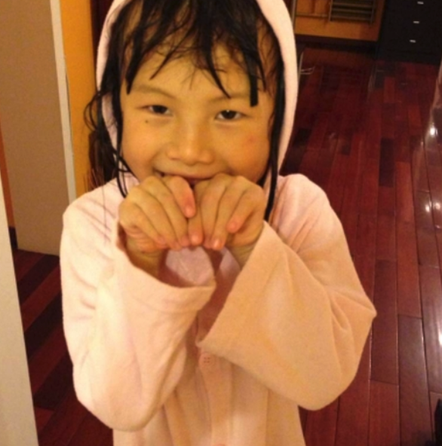
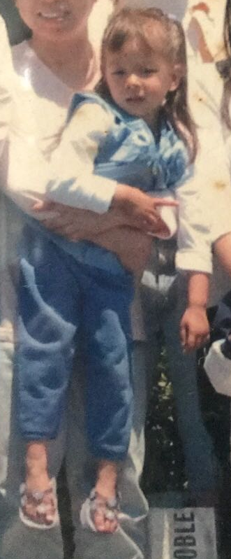
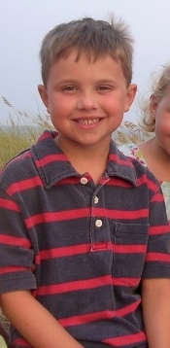
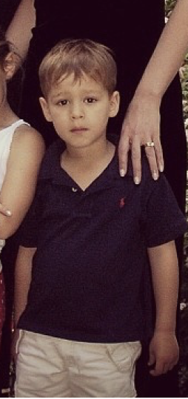
Indy
TAs: Julie, Will, Zach, Zoe
Notes:
3:31

Slide 48
Some info
You design your own project!!
Requirements:
Appropriate length (e.g. not LiteBrite)
Use a data structure
Use an algorithm of moderate complexity (at least as complicated as Tetris’s line clearing)
Originality
Possibilities are endless!
Notes:
3:35 - Zach

Slide 49



Top 5 Reasons to do Indy (1/5)
You won't have to go to TA hours in the Fishbowl and we won't make you use the Google Form ever again.
Notes:
3:36 - Zoe

Slide 50
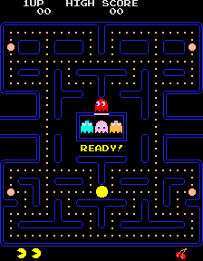
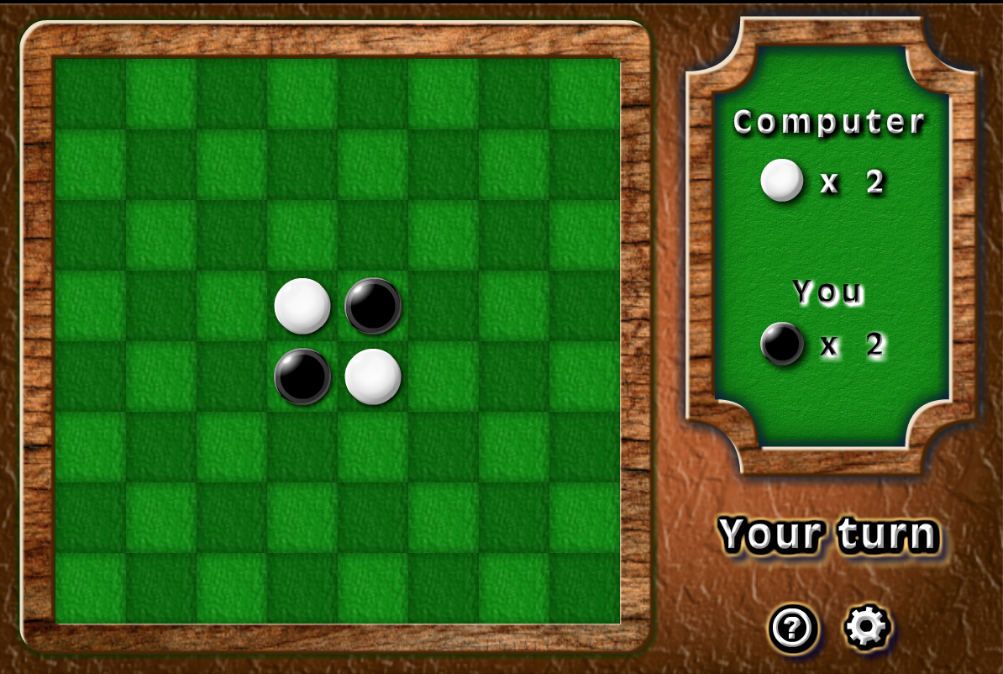
Top 5 Reasons to do Indy (2/5)
1980
1883
Never made it to market
Notes:
3:37 - Will

Slide 51

Top 5 Reasons to do Indy (2/5)
Notes:
3:37 - Will

Slide 52

Top 5 Reasons to do Indy (3/5)
None of Pacman’s reasons were even about Pacman, they were all just about the other FPs
Notes:
3:38 - Julie

Slide 53
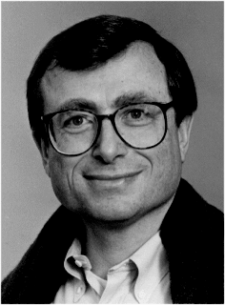
Top 5 Reasons to do Indy (4/5)
Indy is only one letter away from Andy
Notes:
3:38 - Will

Slide 54
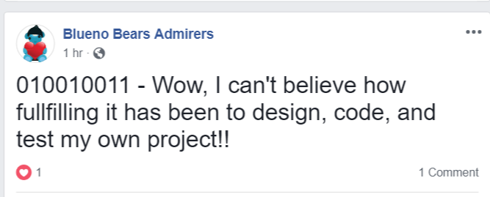
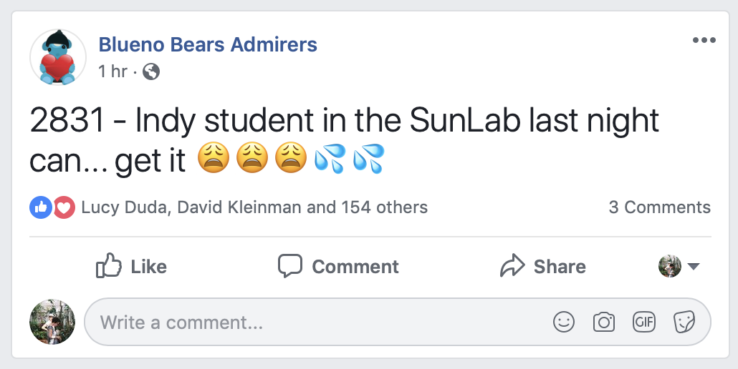
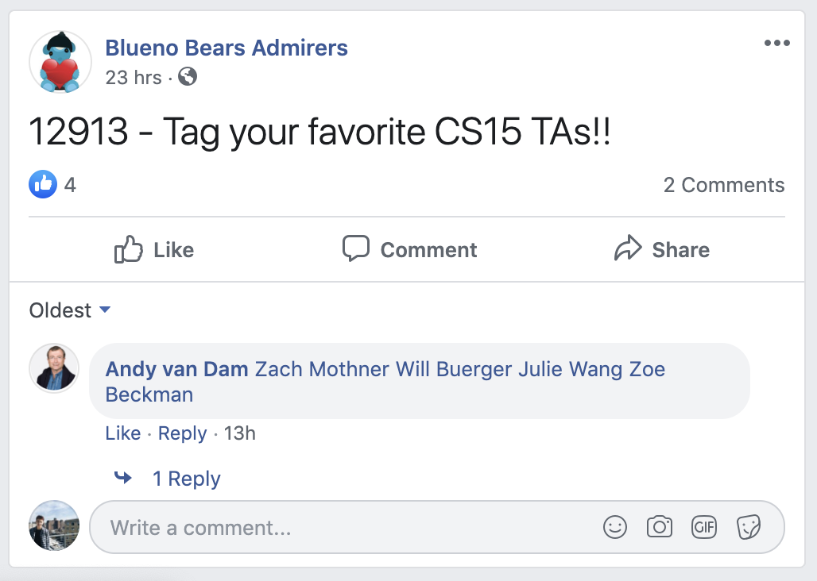
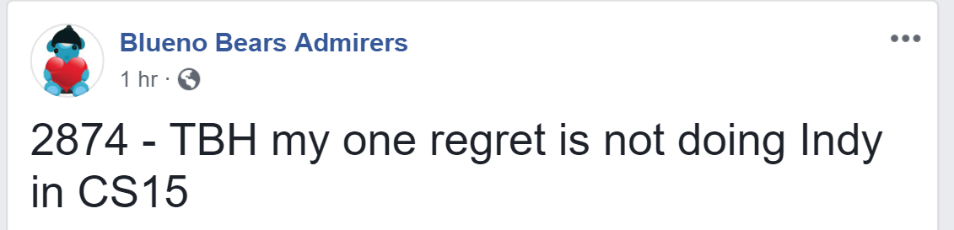
Top 5 Reasons to do Indy (5/5)
Notes:
3:38 - Zach

Slide 55


Top 5 Reasons to do Indy (6/5)
You get to interact with Cooper Birdsall and Cooper Birdsall
You get to interact with Cooper Birdsall and Cooper Birdsall
i mean.. uhh.. zach and will
Notes:
3:39 - Zoe

Slide 56
Demos

Slide 57
Very Important Indy Information
If you’re interested in doing Indy, you should
Develop an initial plan for yours soon. If you have any questions you can email the Indy TAs at: jwang73@cs.brown.edu, wbuerger@cs.brown.edu, zbeckman@cs.brown.edu and zmothner@cs.brown.edu
Find a “backup” Final Project that you’ll do in case your project doesn’t get approved
Send us a project proposal by THIS THURSDAY MIDNIGHT
Keep in mind—Indy is a much larger time commitment than the other final projects
You’ll be responsible for creating your own program specs and design (other projects already have this planned out)
There’s a lot of freedom in this assignment—be comfortable with the lack of structure!
It’s a lot of work, but a lot of fun!
Notes:
3:46 - Julie

Slide 58
Announcements

Slide 59
Announcements
Final Project Help Sessions during class time *this Thursday*
Locations were sent out in email yesterday
Make sure to read the handout thoroughly before coming—it’ll save you lots of time down the road
Fill out the Final Project Declaration form by Saturday 11:59 pm
You will only be able to sign up for hours for the project you pick, so think carefully!
Tetris late deadline is today at 11:59 pm
Notes:
3:50??

